Slide 1
Biodiversity and it’s Conservation

Slide 2
Biodiversity
Definition: Biodiversity or Biological diversity refers to the vast range of life forms, from simple microscopic , unicellular to the evolved, complex and multicellular forms on earth.

Slide 3
Levels of Biodiversity
Genetic diversity:
eg. rice- belongs to species Oryza Sativa shows 1000s of wild & cultivated variety.
2. Species diversity:
eg. Variety of species of plant and animal
3. Ecosystem diversity:
eg. Variety of ecosystem based on habitat

Slide 4
Biogeographical classification of India
Divided in to seven prominent regions
Cold Himalayan mountain region
Arid and semi arid region in central and western part
3. Gangatic plains
4. Long coastal belt on the east and west side
5. Deccan plateau
6. Island ecosystem of Andaman and Nicobar Islands
7. Lakshadweep Islands

Slide 5
Values of biodiversity
It is nothing but importance of biodiversity
Consumptive value
Food, fodder: 80000 edible plant species are found to be wild.
Drug and medicine:
Penicillin obtained from Penicillium fungus used as antibiotic
Tetracycline obtained from bacterium used as antibiotic
Quinine obtained from Cinchona tree used to cure malaria
Digitalin obtained from Digitalis- used to cure heart ailments
Fuel: Fossil fuels are resultant of fossilization of previous biodiversities.
Coal, petroleum, natural gas

Slide 6
Values of biodiversity
2. Productive value: Commercially valuable products sold in market
Textile industry- cotton
silk industry obtains silk from silk warm
Paper and pulp industry, furniture making industry, railway sleeper industry uses timber
musk from Musk deer
Tusk from tusker elephant
Fur of many animals

Slide 7
Values of biodiversity
3. Social value:
Most significant value of biodiversity. We use many plants in our daily life for worshiping .
Tribal people closely linked with forest. Their social life, songs, dances are closely oven around the wild life.
Festivals

Slide 8
Values of biodiversity
Ethical value: Its our moral responsibility to protect our mother earth.
eg. Live and let live
5. Aesthetic value: Appreciation of beauty of nature
eg. Ecotourism, bird watching, jungle safari, pet keeping, gardening
6. Option value: Research related to biodiversity to invent new species which are still unknown.

Slide 9
Categories of species
Endemic species
eg., Indian Gaur, Malabar Giant squirrel, great Indian horn bill
Exotic species
eg. One horned Rhino, Asiatic lion, snow leopard, Nilgiri tahr
Threatened species
eg. Asiatic lion, Gharial, Himalayan quail, Nilgiri tahr
4. Endangered species
eg. Indian Rhino,, Sandal wood
5. Extinct species
eg. Chitah, pink headed duck, mountain quail
6. Vulnerable species
eg. Barasingha, Blackbuck, Olive Ridley turtle
Rare species
eg. Red panda, Indian bison

Slide 10
India as Mega diversity region
India is one of the 12 mega biodiversity countries in the world. The country is divided into 07 biogeographic regions. The diverse physical features and climatic situations have formed ecological habitats like forests, grasslands, wetlands, coastal and marine ecosystems and desert ecosystems, which harbor and sustain immense biodiversity.
Two Hot spots in India
Western Ghats
North Eastern Himalayan mountain

Slide 11
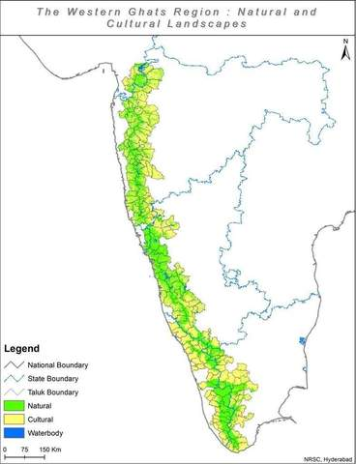
Western Ghats as biodiversity region

Slide 12
Western Ghats as biodiversity region
Locally known as Sahyadri
Parallel to west coast, runs to a full length of 1600 km.
Starts from mouth of river Tapi in Dhule district of maharashtra and ends in Kanyakumari
Covers an area around 1,60,000sq.km supports and supports population of 45 million
Major rivers- Krishna , Bhima, Tungabhadra, Cauvery, Kali, Saraswati, etc. covers about 20% of utilizable water of India
Rainfall- 2000 to 7000 mm/yr. 80% during monsoon.
Forest included are evergreen, semievergreen, moist and dry deciduous, subtropical hill forests

Slide 13
Western Ghats as biodiversity region
WG covers around 25% of Indian forest.
30% species are found at WG, out of that nearly 50% are endemic to WG.
Forests are rich in orchids, medicinal plants, trees and many other species.
More than 5000 flowering plants species, 1800 non flowering, 139 mammals, 58 birds, 179 amphibian, 6000 insects and 290 fresh water fish species are observed.
325 globally threatened species

Slide 14
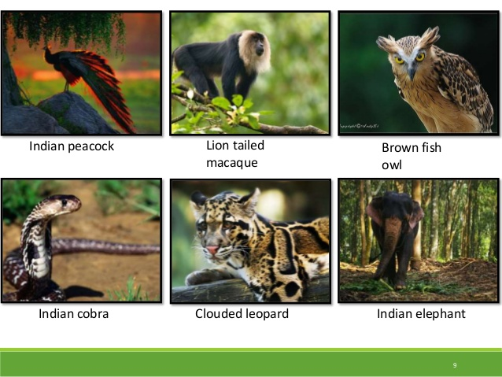
Western Ghats as biodiversity region

Slide 15
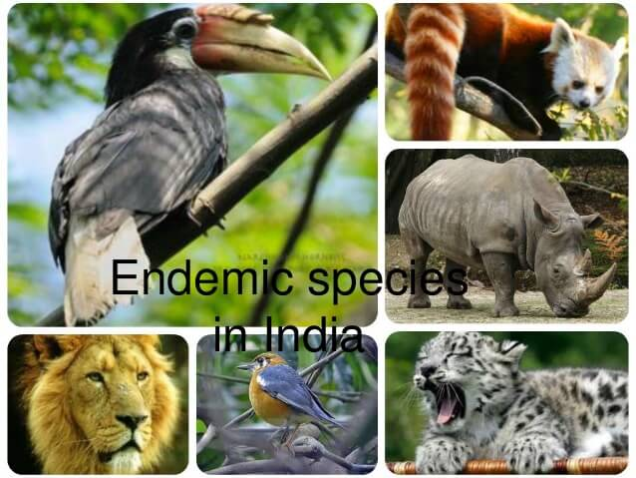
Western Ghats as biodiversity region

Slide 16
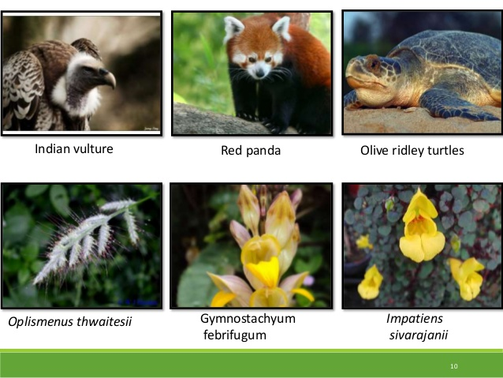
Western Ghats as biodiversity region

Slide 17
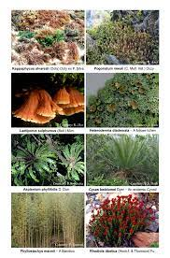
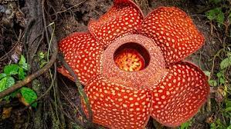
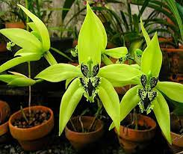
Western Ghats as biodiversity region

Slide 18
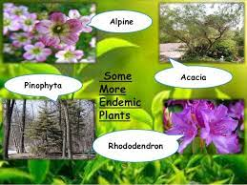
Western Ghats as biodiversity region

Slide 19
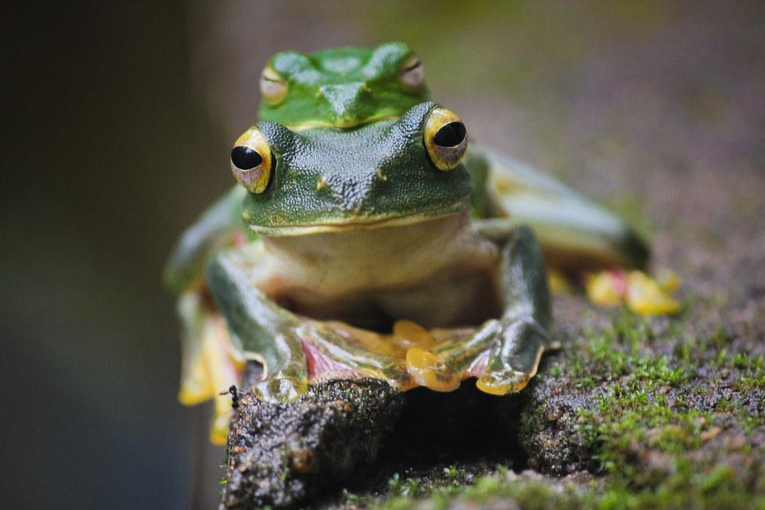
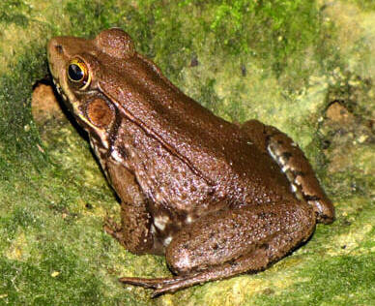
Western Ghats as biodiversity region
Bronze frog
Malabar Gliding frog

Slide 20
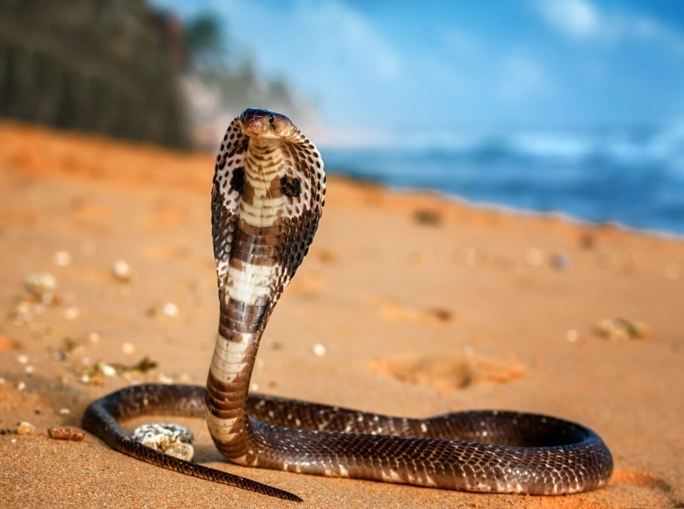
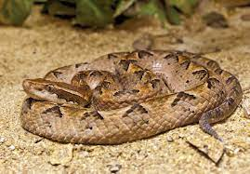
Western Ghats as biodiversity region
Malabar pit viper
Indian cobra

Slide 21
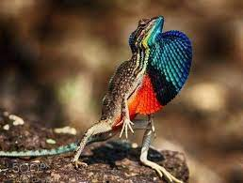
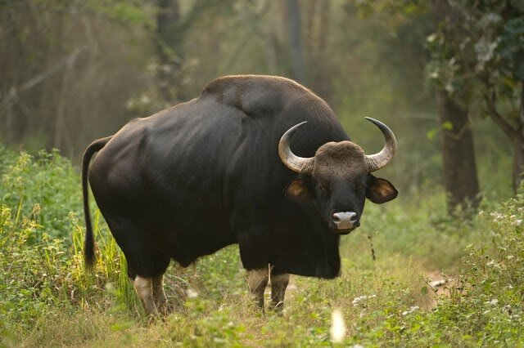
Western Ghats as biodiversity region

Slide 22
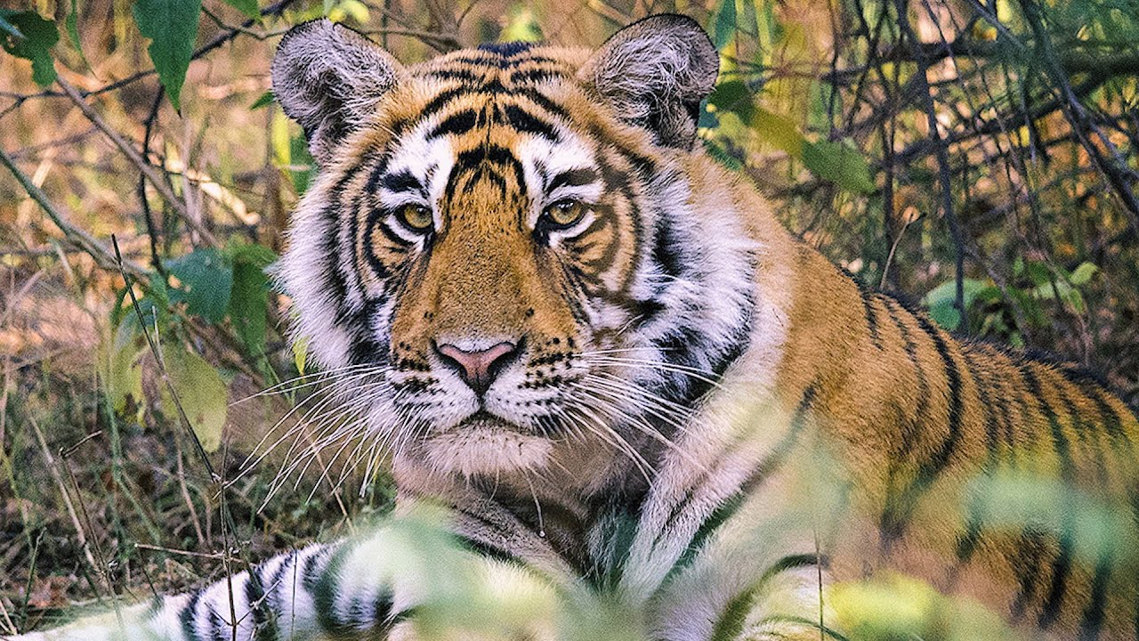
Western Ghats as biodiversity region

Slide 23
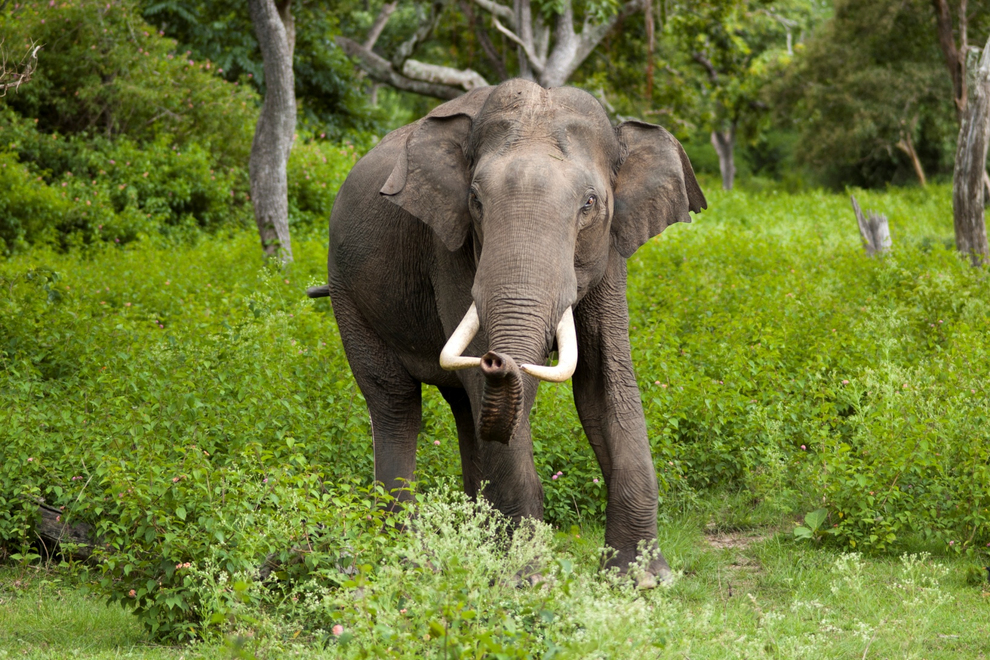
Western Ghats as biodiversity region

Slide 24
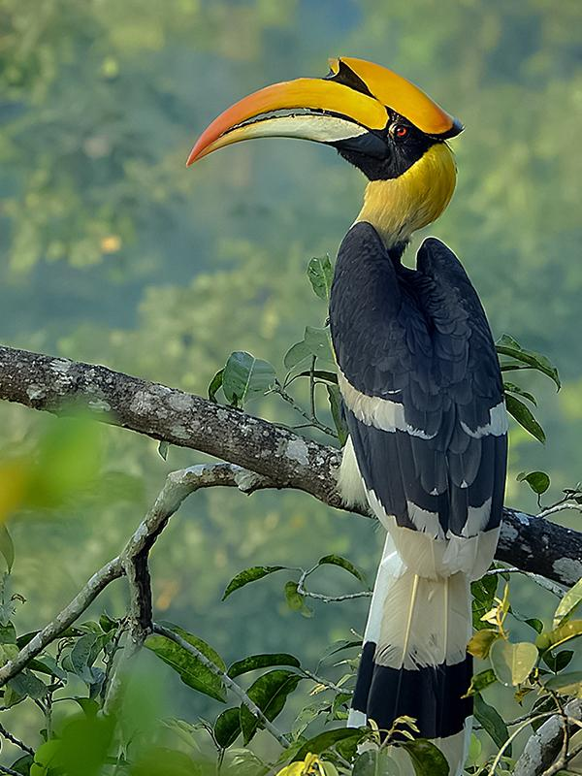
Western Ghats as biodiversity region

Slide 25
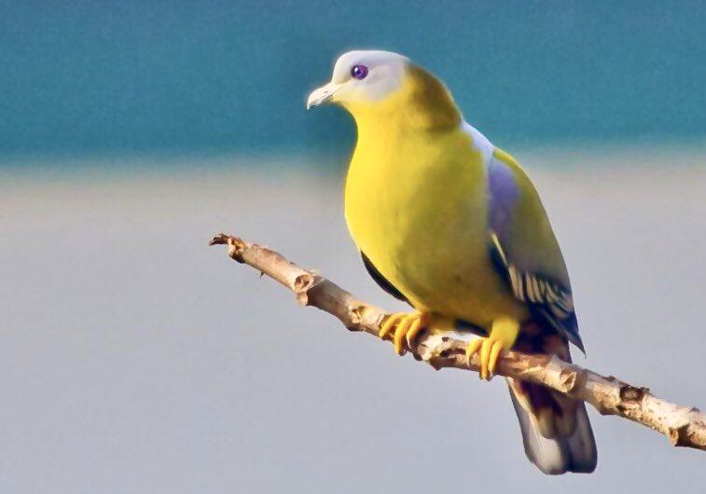
Western Ghats as biodiversity region

Slide 26
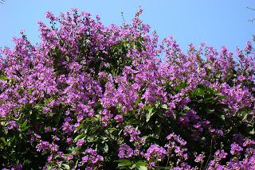
Western Ghats as biodiversity region

Slide 27
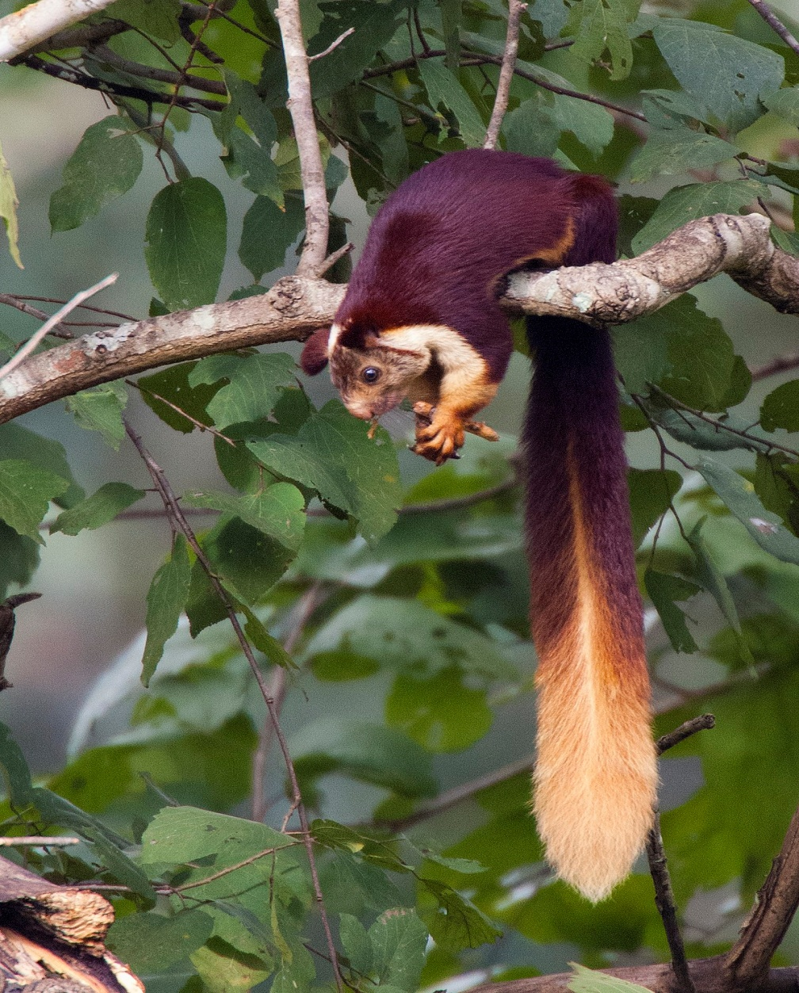
Western Ghats as biodiversity region

Slide 28
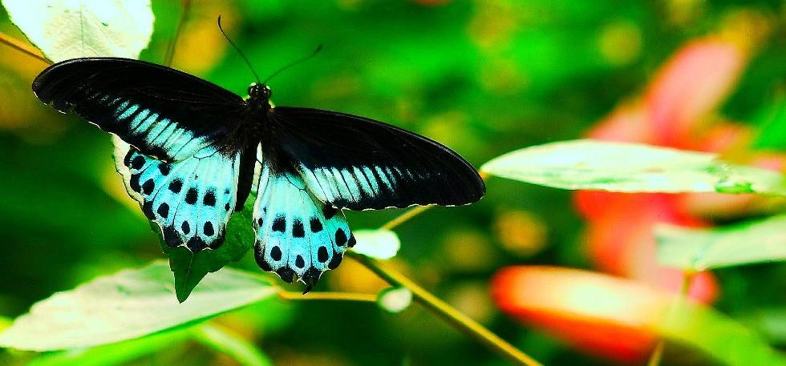
Western Ghats as biodiversity region
Blue Mormon

Slide 29
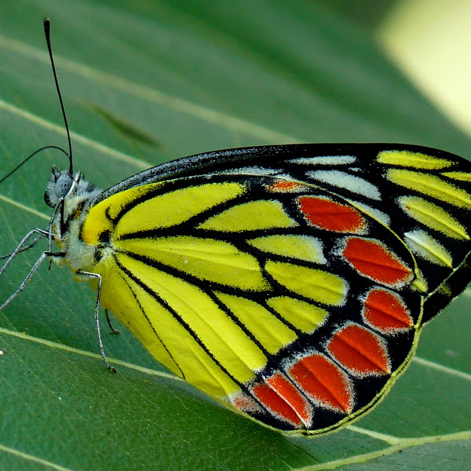
Western Ghats as biodiversity region

Slide 30
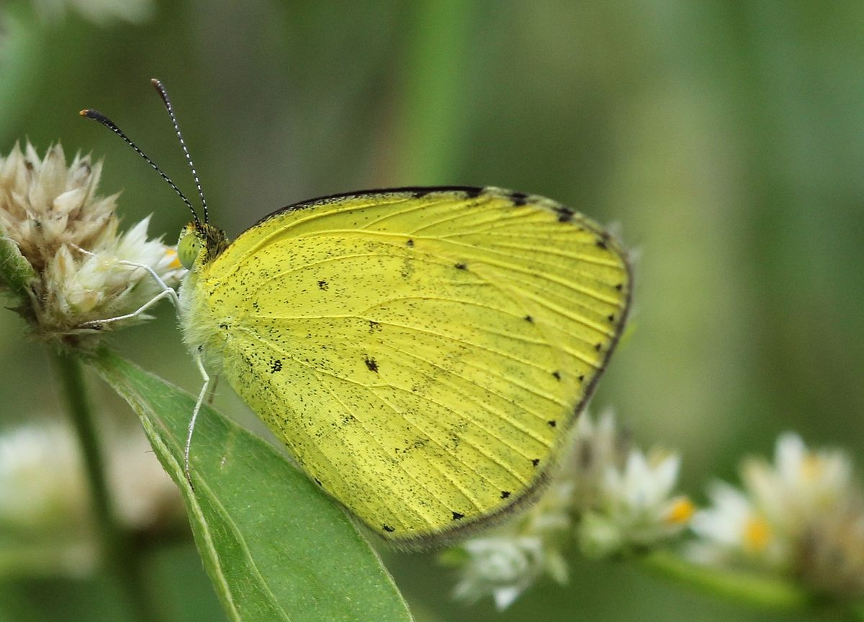
Western Ghats as biodiversity region

Slide 31
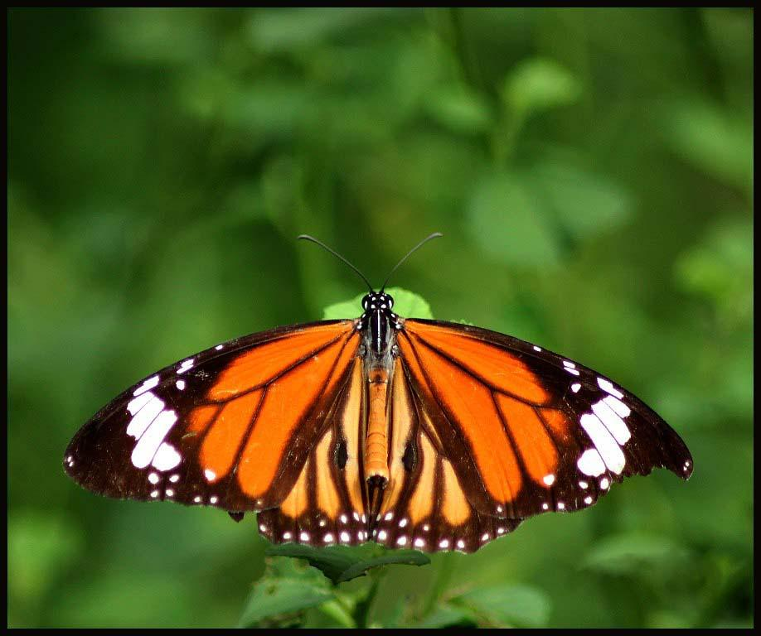
Western Ghats as biodiversity region

Slide 32
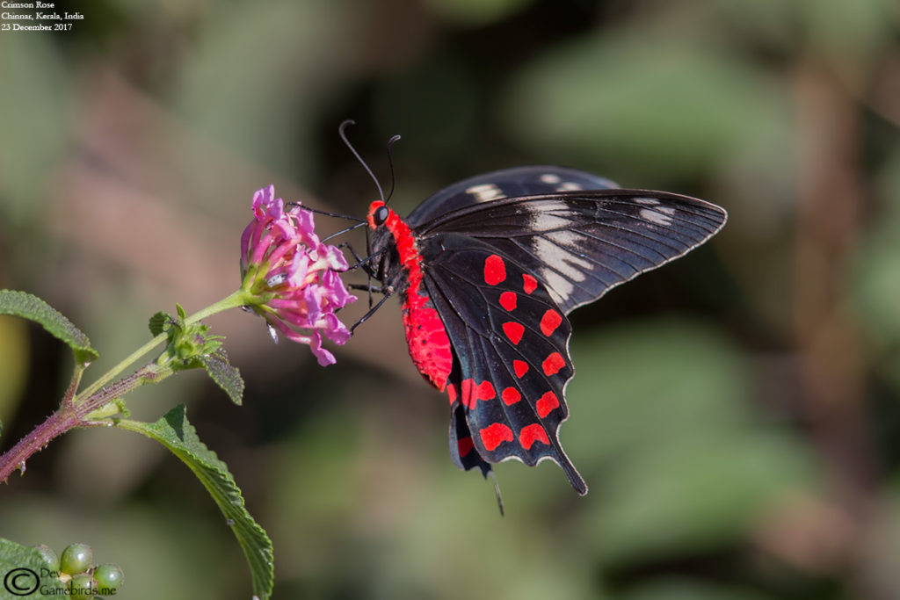
Western Ghats as biodiversity region

Slide 33
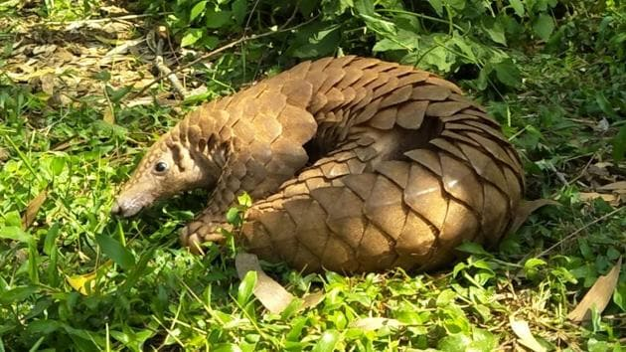
Western Ghats as biodiversity region

Slide 34
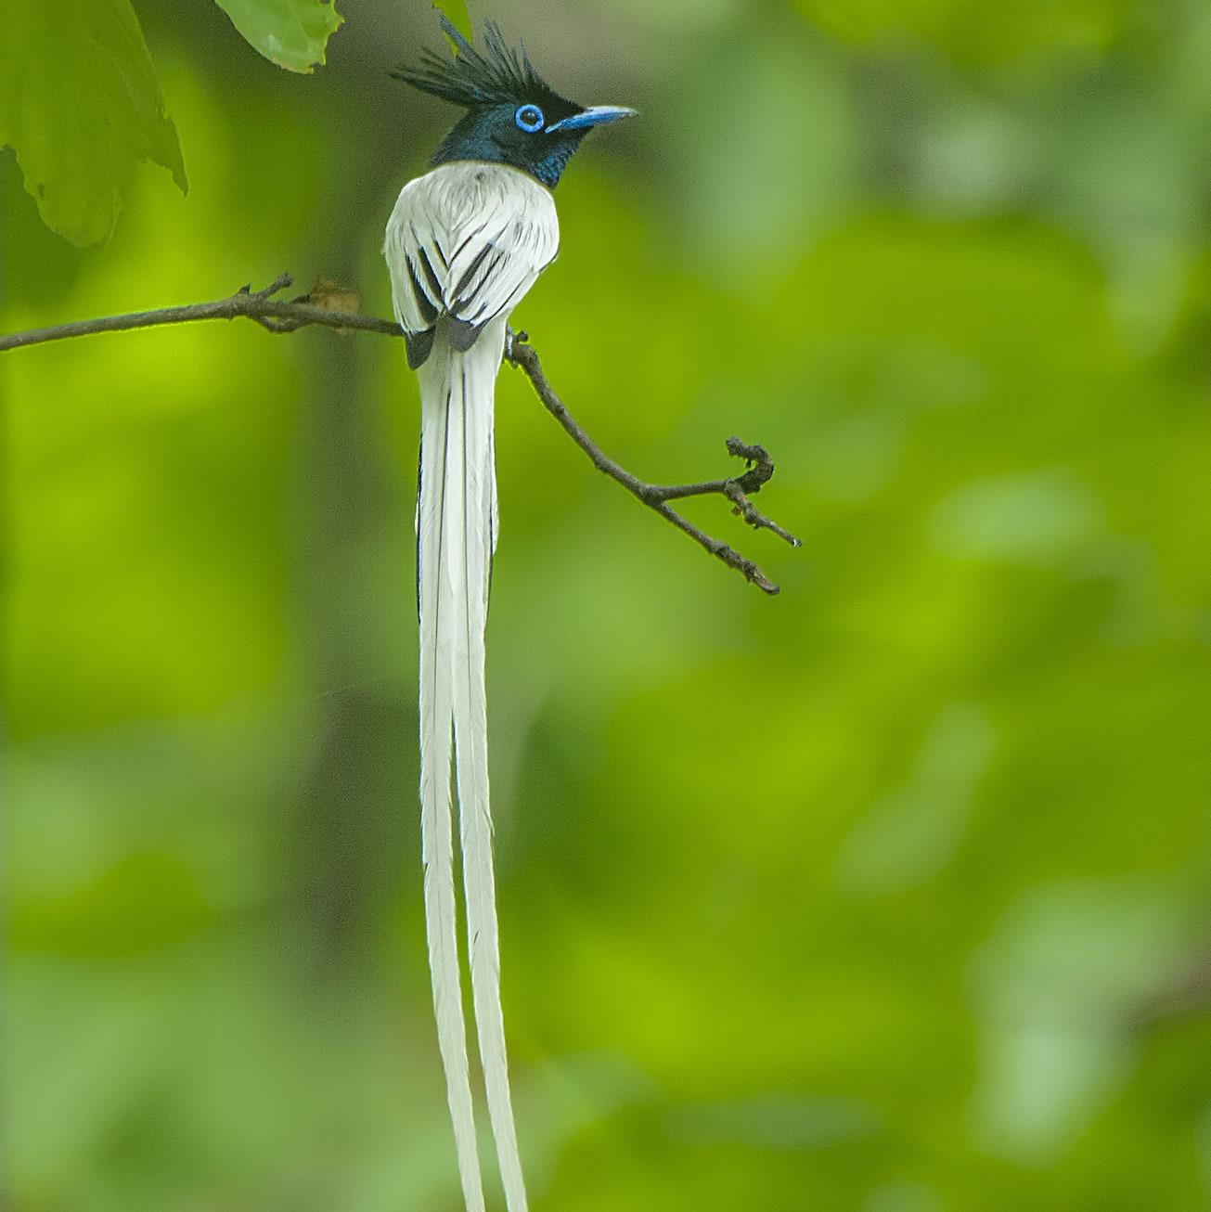
Western Ghats as biodiversity region

Slide 35
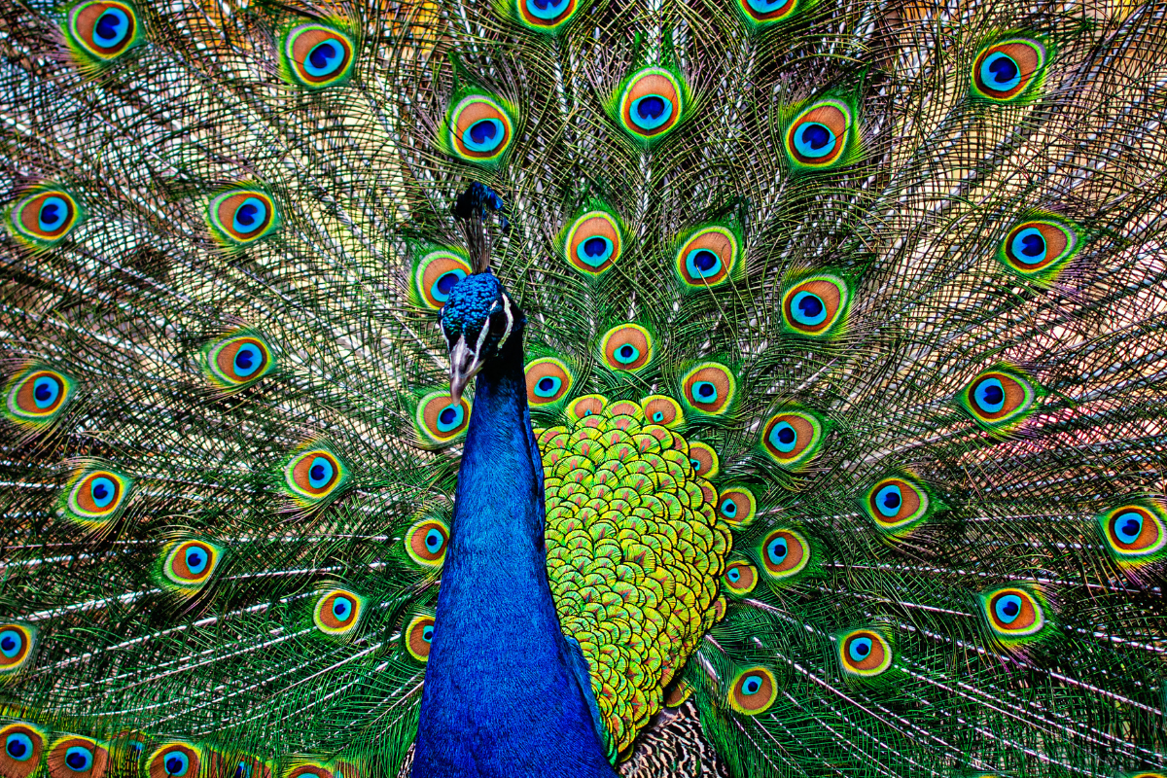
Western Ghats as biodiversity region

Slide 36
Threats to biodiversity
1.Loss of habitat
Deforestation
Damage to wetlands
Habitat fragmentation
2. Poaching
3. Man and wild life conflict

Slide 37
Conservation of biodiversity
IN- SITU conservation
Biosphere reserves
National parks
Wild life sanctuaries
B. EX- SITU conservation

Slide 38
IN- SITU conservation- Biosphere reserve
Sr.No. | Biosphere reserve | State
1 | Nilgiri Biosphere Reserve | Tamil Nadu, Kerala and Karnataka
2 | Gulf of Mannar Biosphere Reserve | Tamil Nadu
3 | Sundarbans Biosphere Reserve | West Bengal
4 | Nanda Devi Biosphere Reserve | Uttarakhand
5 | Nokrek Biosphere Reserve | Meghalaya
6 | Pachmarhi Biosphere Reserve | Madhya Pradesh
7 | Simlipal Biosphere Reserve | Odisha
8 | Great Nicobar Biosphere Reserve | Andaman & Nicobar Islands
9 | Achanakmar-Amarkantak Biosphere Reserve | Chhattisgarh, Madhya Pradesh
10 | Agasthyamalai Biosphere Reserve | Kerala and Tamil Nadu

Slide 39
IN- SITU conservation- National parks
Sr. No. | Name | State | Protected wildlife
1 | Kaziranga NP | Assam | One horned Rhino
2 | Gir NP | Gujarat | Indian lion
3 | Dachigam NP | J & K | Hangul
4 | Periyar NP | Kerala | Elephant, tiger
5 | Bandipur NP | Karnataka | Elephant
6 | Kanha NP | Madhya Pradesh | Tiger
7 | Corbet NP | Uttarakhand | Tiger
8 | Dudwa NP | Uttar Pradesh | Tiger
9 | Ranthambhore NP | Rajasthan | Tiger
10 | Sariska NP | Rajasthan | Tiger

Slide 40
IN- SITU conservation- Wild life sanctuaries
Sr. No. | Name | State | Protected wildlife
1 | Ghana bird sanctuary | Rajasthan | 300 species of bird including migratory birds
2 | Hazaribagh | Bihar | Tiger, leopard
3 | Sultanpur bird sanctuary | Haryana | Migratory birds
4 | Nal sarovar bird sanctuary | Gujarat | Water birds
5 | Abohar | Punjab | Black duck
6 | Madumalai | Tamil Nadu | Tiger, elephant, leopard
7 | Vedanthangal bird sanctuary | Tamil Nadu | Water birds
8 | Jaladapara | West Bengal | Rhino, elephant, tiger
9 | Wind Ass sanctuary | Gujarat | Wild Ass, wolf, Chinkara

Slide 41
IN- SITU conservation
Project tiger
Gir Lion project
Crocodile breeding project
Project elephant
Snow leopard project
Gene sanctuary for Citrus and Pitcher plant at North east India

Slide 42
EX-SITU conservation
Last alternative to IN SITU conservation
Mainly done for crop variety with the main objective of conserving the total genetic variability of crop species for future improvement or afforestation programs.
Done through
Gene pool/ gene bank (18)
Seed bank
Zoo
Botanical garden

Slide 43
Zoological parks in India
National Zoological Park, Delhi
Mysore Zoo, Mysore
Rajiv Gandhi Zoological Park, Pune
Indira Gandhi Zoological Park, Visakhapatnam
Nehru Zoological Park, Hyderabad
Nandankanan Zoological Park, Bhubaneswar
Arignar Anna Zoological Park, Chennai
Padmaja Naidu Himalayan Zoological Park, Darjeeling
Alipore Zoo, Kolkata
Sakkarbaug Zoological Gardens, Junagadh
Chattbir Zoo, Chandigarh
High Altitude Zoo, Nainital
Gopalpur Zoo, Himachal Pradesh
Gulabh Bagh and Zoo, Udaipur
Lucknow Zoo, Lucknow
Assam State Zoo cum Botanical Garden, Guwahati
Thrissur Zoo, Thrissur

Slide 44
Botanical gardens in India
First in India- Pt. Jawaharlal Nehru Van Udyan
Lalbagh Botanical Gardens, Bangalore
Government Botanical Gardens, Ooty
TNAU Botanical Garden, Coimbatore
The Acharya Jagadish Chandra Bose Indian Botanic Garden, Kolkata
The Agri Horticulture Society of India, Alipore, Kolkata
Lloyd’s Botanical Garden, Darjeeling
National Botanical Research Institute (NBRI), Lucknow
Botanical Garden of Forest Research Institute (FRI), Dehradun

